Slide 1
FindDefault
(Prediction of Credit Card fraud)

Slide 2
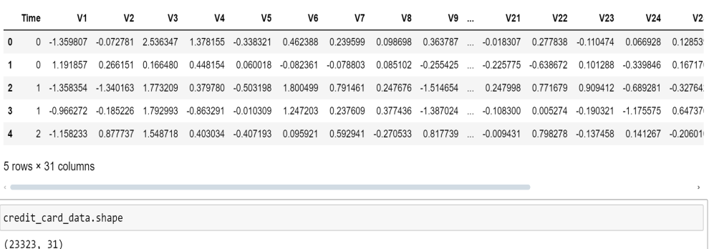
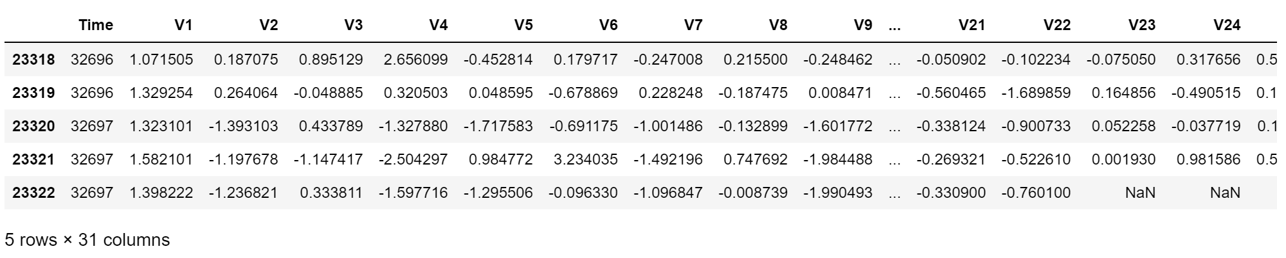
Collect The Time Series Data
Top five
Bottom five

Slide 3
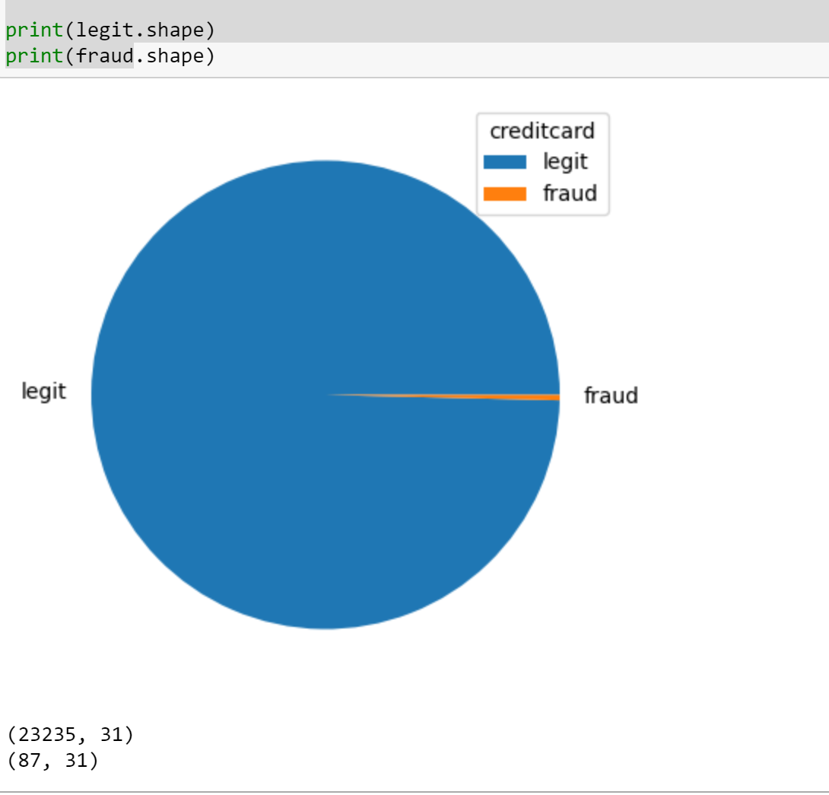
Legit vs Fraud

Slide 4
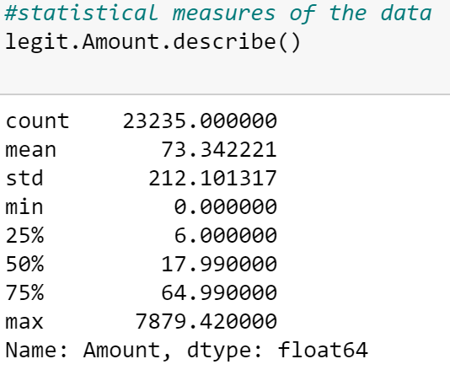
Descriptive Statistics Of Legit

Slide 5
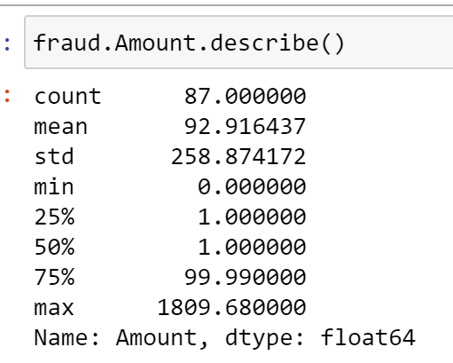
Descriptive Statistics Of Fraud

Slide 6
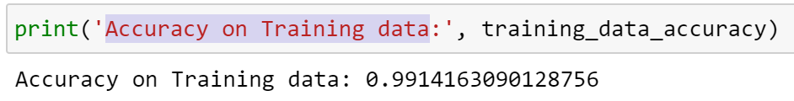
Accuracy On Training Data

Slide 7
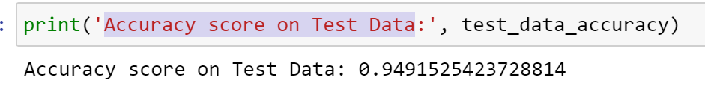
Accuracy Score On Test Data

Slide 8
Conclusion
FindDefault is a powerful tool that uses advanced algorithms and machine learning techniques to analyze patterns and trends in credit card transactions. By examining various factors such as transaction amount, frequency, location, and time of day, FindDefault can accurately predict whether a transaction is likely to be fraudulent. This allows financial institutions to take immediate action to prevent unauthorized charges and protect their customers from potential financial losses.
In conclusion, FindDefault is a crucial tool in the fight against credit card fraud. By leveraging cutting-edge technology and predictive modeling, this tool helps financial institutions detect and prevent fraudulent activities, ultimately safeguarding the financial well-being of their customers. With the ever-evolving landscape of cybercrime, tools like FindDefault are essential in maintaining the security and integrity of the financial sector.

Slide 9
Future Work
After the model has been deployed, the bank plans to provide a second layer of authentication for each of the transactions that the model predicts as fraudulent. If a payment gets flagged by the model, an SMS will be sent to the customer requesting them to call on a toll-free number to confirm the authenticity of the transaction.

